Slide 1
Multidimensional Arrays in Java
Bilal jan

Slide 2
2-Dimensional Array
Recap of Arrays in Java
Collection of data having same data type
Array elements are stored under single variable name at contiguous memory locations
The array locations are indexed from 0 until N-1, where N is size of the array
The array size can be accessed using array.length property
The total number of values i.e., array size is always known ahead and is fixed during the program execution
In dynamic arrays (ArrayList → future topic), expansion and shrinking of array is allowed during the program execution.

Slide 3






Recap of Arrays…
Array → Declaration, Initialization and Accessing
dataType [ ] arrayName = new dataType[ size ]; //Syntax for array declaration
String [] names = new String[5];
int [] marks = new int[5];
char [] letterGrade = new char [5];
float [] pointGrade = new float[5];

Slide 4
Program using Arrays
Description
This program will ask from user to
Enter names of 5 different students
Enter marks per student in a particular subject
Enter the letter grade obtained
The program then displays the student names, marks obtained and the corresponding grade column wise, as in next-slide.

Slide 5
Program using Arrays…
Desired Output
Student Name Marks Obtained Grade Obtained
Peter 90 A
Jones 80 B
Ali 70 C
Sarah 80 B
Danial 60 D

Slide 6
Student Record Entry and Output
import java.util.Scanner;
public class Array {
public static void main(String commandLineArg[]) {
String[] names = new String[5];
int [] marks = new int[5];
char[] letterGrade = new char[5];
Scanner scanner=new Scanner(System.in);
}
}
Before actually writing the program we should do some paper work about
Number of arrays, I will be dealing with
Functions, I may need to define
Generic flow of the program
For this program, we will need 3 arrays.
We will also need Scanner class object for taking input from console using loop
Viola, that is the basic skeleton of the program!

Slide 7
Student Record Entry and Output…
…in continuation with code above…
int i;
for(i=0;i<5;i++) {
System.out.println("Enter name of student no. "+(i+1));
names[i]=input.next();
}
for(i=0;i<5;i++) {
System.out.println("Enter marks obtained by student no. "+(i+1));
marks[i]=Integer.parseInt(input.next());
System.out.println("Enter the letter grade awarded ");
letterGrade[i]=input.next().charAt(0);
}
As said, we will need 3 arrays
An array for storing names
Another array for storing obtained marks, and
Another array for storing awarded grade.
We will also need a loop for taking values from user and storing in corresponding array location.
Variable i is used as index variable, here.
For simplicity, we use for loop
At this point we have input all our required.
Lets write code to display it.

Slide 8
Student Record Entry and Output…
Code for formatted output
Some points that need clarification.
The Scanner class object input in this case returns string value when called for built in function next() i.e. input.next().
This return string value must be type-casted when assigning to a variable of a different type. e.g.
marks[i]=Integer.parseInt(input.next());
Above statement takes string values from user say “90” and converts to integer i.e. 90.
letterGrade[i]=input.next().charAt(0);
This statement converts letter grade say “A” into character ‘A’ that is accessed as character stored at zero’th location of the returned string →input.next().
System.out.println("Student Name"+"\t"+"Marks Obtained"+"\t"+"Grade Awarded");
for(i=0;i<5;i++) {
System.out.println(names[i]+"\t\t"+marks[i]+"\t\t"+letterGrade[i]);
}

Slide 9
Complete Program
for(i=0;i<5;i++) {
System.out.println("Enter marks obtained by student no. "+(i+1));
marks[i]=Integer.parseInt(input.next());
System.out.println("Enter the letter grade awarded ");
letterGrade[i]=input.next().charAt(0);
}
System.out.println("\n*****OUTPUT*****\n");
System.out.println("Student Name"+"\t"+"Marks Obtained"+"\t"+"Grade Awarded");
for(i=0;i<5;i++) {
System.out.println(names[i]+"\t\t"+marks[i]+"\t\t"+letterGrade[i]);
}
}
}
import java.util.Scanner;
public class Array {
public static void main(String commandLineArg[]) {
String[] names = new String[5];
int [] marks = new int[5];
char[] letterGrade = new char[5];
Scanner input=new Scanner(System.in);
int i;
for(i=0;i<5;i++) {
System.out.println("Enter name of student no. "+(i+1));
names[i]=input.next();
}

Slide 10
Working and Output of the Program
Enter name of student no. 1
Peter
Enter name of student no. 2
Jones
Enter name of student no. 3
Ali
Enter name of student no. 4
Sarah
Enter name of student no. 5
Danial
Enter marks obtained by student no. 1
90
Enter the letter grade awarded
A
Enter marks obtained by student no. 2
80
Enter the letter grade awarded
B
Enter marks obtained by student no. 3
70
Enter the letter grade awarded
C
Enter marks obtained by student no. 4
80
Enter the letter grade awarded
B
Enter marks obtained by student no. 5
60
Enter the letter grade awarded
D
Student Name Marks Obtained Grade Awarded
Peter 90 A
Jones 80 B
Ali 70 C
Sarah 80 B
Danial 60 D

Slide 11
How to make the above program work even smarter!
Task-1
TASK-2
Update the above program for auto-calculation of the awarded letter grade.
Can we add functions in the existing program to look a bit professional and easily scalable?

Slide 12






TASK-1
Sample Grading Criterion
Update the above program for auto-calculation of the awarded letter grade.
First question in mind. What is the grading criteria?
Sample grading criteria

Slide 13
TASK-1
for(i=0;i<5;i++) {
System.out.println("Enter name of student no. "+(i+1));
names[i]=input.next();
System.out.println("Enter marks obtained by "+names[i]);
marks[i]=Integer.parseInt(input.next());
if(marks[i]<=100 && marks[i]>=90)
letterGrade[i]='A';
else if(marks[i]<90 && marks[i]>=80)
letterGrade[i]='B';
else if(marks[i]<80 && marks[i]>=70)
letterGrade[i]='C';
else if(marks[i]<70 && marks[i]>=60)
letterGrade[i]='D';
else if(marks[i]<60 && marks[i]>=50)
letterGrade[i]='E';
else if(marks[i]>=0 && marks[i]<50)
letterGrade[i]='F';
else
letterGrade[i]='?'; //wrong entry for marks
}
Use of if-else statement to find the interval
Once the interval is found, store the appropriate Letter Grade as per Sample Grading Criteria in the corresponding location.
for e.g. if marks=89 then corresponding grade should be B

Slide 14
Complete Program→ TASK-1
if(marks[i]<=100 && marks[i]>=90)
letterGrade[i]='A';
else if(marks[i]<90 && marks[i]>=80)
letterGrade[i]='B';
else if(marks[i]<80 && marks[i]>=70)
letterGrade[i]='C';
else if(marks[i]<70 && marks[i]>=60)
letterGrade[i]='D';
else if(marks[i]<60 && marks[i]>=50)
letterGrade[i]='E';
else if(marks[i]>=0 && marks[i]<50)
letterGrade[i]='F';
else
letterGrade[i]='?'; //wrong entry for marks
}
System.out.println("\n*****OUTPUT*****\n");
System.out.println("Student Name"+"\t"+"Marks Obtained"+"\t"+"Grade Awarded");
for(i=0;i<5;i++) {
System.out.println(names[i]+"\t\t"+marks[i]+"\t\t"+letterGrade[i]);
}
}
}
import java.util.Scanner;
public class Array_P2 {
public static void main(String commandLineArg[]) {
String[] names = new String[5];
int [] marks = new int[5];
char[] letterGrade = new char[5];
Scanner input=new Scanner(System.in);
int i;
for(i=0;i<5;i++) {
System.out.println("Enter name of student no. "+(i+1));
names[i]=input.next();
System.out.println("Enter marks obtained by "+names[i]);
marks[i]=Integer.parseInt(input.next());

Slide 15
Working and Output of the Program → TASK-1
Enter name of student no. 1
Peter
Enter marks obtained by Peter
56
Enter name of student no. 2
Shah
Enter marks obtained by Shah
76
Enter name of student no. 3
Jones
Enter marks obtained by Jones
58
Enter name of student no. 4
Sarah
Enter marks obtained by Sarah
45
Enter name of student no. 5
Khan
Enter marks obtained by Khan
69
*****OUTPUT*****
Student Name Marks Obtained Grade Awarded
Peter 56 E
Shah 76 C
Jones 58 E
Sarah 45 F
Khan 69 D

Slide 16



TASK-2
Generic Program Structure
Declaration and necessary initialization
Can we add functions in the existing program to look a bit professional and easily scalable?
Function for console input
Function for auto grading
Function for display

Slide 17
TASK-2 (Arrays & Functions)
Basic declaration and initialization
Function for console input
String[] names = new String[5];
int [] marks = new int[5];
char[] letterGrade = new char[5];
Array as function argument
Syntax function call
functionName(arrayName);
Syntax function definition
returnType functionName(datatype [] receiveArrayName){ }
In java passing array name as function argument is treated as pass-by-reference i.e. any change made in the called function is visible inside the caller function.
For instance when the square(numberArray); is called with definition square(int [] numbers) { } the changes (square of each array element) is visible in the return scope where square(numberArray) function is called.

Slide 18
Task-2
Function for console input
Function for auto-grading
Function definition
public static void recordEntry(String [] nameArray, int[] marks) {
Scanner input = new Scanner(System.in);
for(int i=0;i<nameArray.length;i++) {
System.out.println("Enter name of student no. "+(i+1));
nameArray[i]=input.next();
System.out.println("Enter marks obtained by "+nameArray[i]);
marks[i]=Integer.parseInt(input.next());
}
input.close();
}
Function call
recordEntry(names,marks);
Function definition
public static char awardGrade(int marks) {
char grade='&';
if(marks<=100 && marks>=90)
grade='A';
else if(marks<90 && marks>=80)
grade='B';
else if(marks<80 && marks>=70)
grade='C';
else if(marks<70 && marks>=60)
grade='D';
else if(marks<60 && marks>=50)
grade='E';
else if(marks>=0 && marks<50)
grade='F';
else
grade='?'; //wrong entry for marks
return grade;
Function call
letterGrade[i]=awardGrade(marks[i]);
//loop over the function call

Slide 19
Task-2
Function for display
Function definition
public static void display(String[] names, int marks[], char[] grades) {
System.out.println("\n*****OUTPUT*****\n");
System.out.println("Student Name"+"\t"+"Marks Obtained"+"\t"+"Grade Awarded");
for(int i=0;i<5;i++) {
System.out.println(names[i]+"\t\t"+marks[i]+"\t\t"+grades[i]);
}
}
Function call
display(names, marks,letterGrade);

Slide 20
Complete Program
Task-2
import java.util.Scanner;
public class Array_P3 {
public static void recordEntry(String [] nameArray,int [] marks) {
Scanner input = new Scanner(System.in);
for(int i=0;i<nameArray.length;i++) {
System.out.println("Enter name of student no. "+(i+1));
nameArray[i]=input.next();
System.out.println("Enter marks obtained by "+nameArray[i]);
marks[i]=Integer.parseInt(input.next());
}
input.close();
}
public static char awardGrade(int marks) {
char grade='&';
if(marks<=100 && marks>=90)
grade='A';
else if(marks<90 && marks>=80)
grade='B';
else if(marks<80 && marks>=70)
grade='C';
else if(marks<70 && marks>=60)
grade='D';
else if(marks<60 && marks>=50)
grade='E';
else if(marks>=0 && marks<50)
grade='F';
else
grade='?'; //wrong entry for marks
return grade;
}
public static void display(String[] names, int marks[], char[] grades) {
System.out.println("\n*****OUTPUT*****\n");
System.out.println("Student Name"+"\t"+"Marks Obtained"+"\t"+"Grade Awarded");
for(int i=0;i<5;i++) {
System.out.println(names[i]+"\t\t"+marks[i]+"\t\t"+grades[i]);
}
}
public static void main(String commandLineArg[]) {
String[] names = new String[5];
int [] marks = new int[5];
char[] letterGrade = new char[5];
int i;
recordEntry(names,marks);
for(i=0;i<5;i++) {
letterGrade[i]=awardGrade(marks[i]);
}
display(names, marks,letterGrade);
}//end of main
}//end of class

Slide 21
Working and Output of the Program → TASK-2
Enter name of student no. 1
Ali
Enter marks obtained by Ali
65
Enter name of student no. 2
Zain
Enter marks obtained by Zain
80
Enter name of student no. 3
Khan
Enter marks obtained by Khan
74
Enter name of student no. 4
Soni
Enter marks obtained by Soni
78
Enter name of student no. 5
Parker
Enter marks obtained by Parker
94
*****OUTPUT*****
Student Name Marks Obtained Grade Awarded
Ali 65 D
Zain 80 B
Khan 74 C
Soni 78 C
Parker 94 A

Slide 22















Task-3
What if we are asked to enter record of students for 3 different subjects??
There are several ways to solve this.
But we will use 2Dimensional Array like the one on → right side

Slide 23
2 Dimensional Arrays

Slide 24





2 dimensional arrays
Multi dimensional arrays are array of arrays.
It can be 2 dimensional, 3 dimensional or more.
A typical example of 2D array is a matrix (MxN→rows x columns), where each row is a linear array of length i.e. number of columns in it, N.
Declaring a two dimensional array of 4 rows and 3 columns (four integer arrays each of size 3→ remember Array of Arrays)
int [][] array= new int[4][3]
Here no. of rows = 4 and no. of columns=3

Slide 25
2D array: A simple example
We are asked to store hourly temperature for 3 hours (e.g. 8:00am to 10:00am) of 4 different cities (e.g. city no 1. to city no. 4).
Let’s assume the temperature values entered are decimal.
We will use a 2D array of size 4 x 3
import java.util.Scanner;
public class Array_P4 {
public static void main(String commandLineArg[]) {
double[][] temperature = new double[4][3];
Scanner scanner = new Scanner(System.in);
for (int i = 0; i < 4; i++)
for (int j = 0; j < 3; j++) {
System.out.println("Enter temperature of city " + (i + 1) + " for Hour: “
+(j+8)+":00am");
temperature[i][j] = scanner.nextDouble();
}
for (int i = 0; i < 4; i++) {
System.out.println("Hourly temperature of City no. "+(i+1));
for (int j = 0; j < 3; j++) {
System.out.print((j+8)+":00am "+ temperature[i][j] + " Celsius ");
}
System.out.println();
}
}
}

Slide 26
Working and output
Enter temperature in Celsius of city 4 for Hour: 8:00am
7
Enter temperature in Celsius of city 4 for Hour: 9:00am
9
Enter temperature in Celsius of city 4 for Hour: 10:00am
10
Hourly temperature of City no. 1
8:00am 10.0 Celsius 9:00am 11.0 Celsius 10:00am 14.0 Celsius
Hourly temperature of City no. 2
8:00am 1.0 Celsius 9:00am 3.0 Celsius 10:00am 4.0 Celsius
Hourly temperature of City no. 3
8:00am 20.0 Celsius 9:00am 22.0 Celsius 10:00am 25.0 Celsius
Hourly temperature of City no. 4
8:00am 7.0 Celsius 9:00am 9.0 Celsius 10:00am 10.0 Celsius
Enter temperature in Celsius of city 1 for Hour: 8:00am
10
Enter temperature in Celsius of city 1 for Hour: 9:00am
11
Enter temperature in Celsius of city 1 for Hour: 10:00am
14
Enter temperature in Celsius of city 2 for Hour: 8:00am
1
Enter temperature in Celsius of city 2 for Hour: 9:00am
3
Enter temperature in Celsius of city 2 for Hour: 10:00am
4
Enter temperature in Celsius of city 3 for Hour: 8:00am
20
Enter temperature in Celsius of city 3 for Hour: 9:00am
22
Enter temperature in Celsius of city 3 for Hour: 10:00am
25

Slide 27

Back to Task-3
Solution using 2D arrays for subject marks and awarded grades
String [] names = new String[5]
int [][] marks = new marks[5][3]; //each student is examined in 3 subjects
char [][] grade = new grade[5][3]; //each student is awarded grade per subject
What if we are asked to enter record of students for 3 different subjects??
(remember Student Names, marks and awarded grade program, not? Rewind )
Always keep in memory the golden rule, when dealing with nested loops
“for each iteration of the outer loop the inner loop executes completely”.
i.e. for each student we need to enter marks for all the three subjects and award the grades per subject.

Slide 28
Task3
import java.util.Scanner;
public class Array_P5 {
public static void recordEntry(String [] nameArray,int [][] marks) {
Scanner input = new Scanner(System.in);
for(int i=0;i<nameArray.length;i++) {
System.out.println("Enter name of student no. "+(i+1));
nameArray[i]=input.next();
for(int j=0;j<3;j++) {
System.out.println("Enter marks obtained by "+nameArray[i]+" in subject no. "+(j+1));
marks[i][j]=Integer.parseInt(input.next());
}
}
input.close();
}
public static char awardGrade(int marks) {
char grade='&';
if(marks<=100 && marks>=90)
grade='A';
else if(marks<90 && marks>=80)
grade='B';
else if(marks<80 && marks>=70)
grade='C';
else if(marks<70 && marks>=60)
grade='D';
else if(marks<60 && marks>=50)
grade='E';
else if(marks>=0 && marks<50)
grade='F';
else
grade='?'; //wrong entry for marks
return grade;
}

Slide 29
public static void display(String[] names, int [][] marks, char[][] grades) {
System.out.println("\n*****OUTPUT*****\n");
//for simplicity we use i for student and j for subject
for(int i=0;i<5;i++) {
System.out.println("Record of "+names[i]+"\nMarks obtained");
for(int j=0;j<3;j++)
System.out.print(marks[i][j]+"\t");
System.out.println("\nGrades awarded");
for(int j=0;j<3;j++)
System.out.print(grades[i][j]+"\t");
}
System.out.println("\n\nAll Students Record");
System.out.println("\nMarks Obtained");
for(int i=0;i<5;i++) {
for(int j=0;j<3;j++)
System.out.print(marks[i][j]+"\t");
System.out.print("\n");
}
System.out.println("\nGrades Awarded");
for(int i=0;i<5;i++) {
for(int j=0;j<3;j++)
System.out.print(grades[i][j]+"\t");
System.out.print("\n");
}
}
public static void main(String commandLineArg[]) {
String[] names = new String[5];
int [][] marks = new int[5][3];
char[][] grade = new char[5][3];
int rollNo,subjectNo;
recordEntry(names,marks);
for(rollNo=0;rollNo<5;rollNo++)
for(subjectNo=0;subjectNo<3;subjectNo++){
grade[rollNo][subjectNo]=awardGrade(marks[rollNo][subjectNo]);
}
display(names, marks,grade);
System.out.println("\n****************end of program******************");
}
}

Slide 30
Working and Output of the Program → TASK-3
Enter marks obtained by Peter in subject no. 3
88
Enter name of student no. 5
Bilal
Enter marks obtained by Bilal in subject no. 1
91
Enter marks obtained by Bilal in subject no. 2
98
Enter marks obtained by Bilal in subject no. 3
71
*****OUTPUT*****
Record of Ali
Marks obtained
76 87 97
Grades awarded
C B A Record of Zara
Marks obtained
65 56 87
Grades awarded
D E B Record of Jones
Marks obtained
88 76 70
Grades awarded
B C C Record of Peter
Marks obtained
80 90 88
Grades awarded
B A B Record of Bilal
Marks obtained
91 98 71
Grades awarded
A A C
All Students Record
Marks Obtained
76 87 97
65 56 87
88 76 70
80 90 88
91 98 71
Grades Awarded
C B A
D E B
B C C
B A B
A A C
****************end of program******************
Enter name of student no. 1
Ali
Enter marks obtained by Ali in subject no. 1
76
Enter marks obtained by Ali in subject no. 2
87
Enter marks obtained by Ali in subject no. 3
97
Enter name of student no. 2
Zara
Enter marks obtained by Zara in subject no. 1
65
Enter marks obtained by Zara in subject no. 2
56
Enter marks obtained by Zara in subject no. 3
87
Enter name of student no. 3
Jones
Enter marks obtained by Jones in subject no. 1
88
Enter marks obtained by Jones in subject no. 2
76
Enter marks obtained by Jones in subject no. 3
70
Enter name of student no. 4
Peter
Enter marks obtained by Peter in subject no. 1
80
Enter marks obtained by Peter in subject no. 2
90

Slide 31
Multidimensional Arrays and File io
Can we write the output of previous program to a text file stored on hard drive?
Yes, we can.
We will need basic understanding of how Java treats files for input and output → File io?
But the basic question still remains uncleared, Why we need input or output to a file?
The simple answer is that Java programs take input, process it and produce output stored in memory (RAM) in the form of different interacting variables. These variables and the contents therein are lost once the executables are closed. Yeah! That’s the volatile nature of Random Access Memory.
For permanent storage of input or output i.e. for long term access Java programs are enabled to read from or write to files stored on secondary storages.
Data stored or read from files is retained even after the program terminates.

Slide 32
Java File io
Java treats each file as stream (sequence) of bytes delimited by an end-of-file marker at the end.
Java File streams can access (read or write) files as Byte-based streams and Character-based streams.
Here the Input/Output i.e. i/o stream refers to the source from where the file is read from or the destination where data will be written to, respectively.
For standard in/output, we use stream objects in form of System.in and System.out for input/output from keyboard and on to the screen.
These traditional stream objects can also be redirected from standard input (keyboard) and standard output (screen) to different devices for i/o operations.

Slide 33
Java Filo.io
Java File.io package (import java.file.io) provides the definitions for stream and other related classes used in file handling.
Two basic file operations i.e. read and write
Two ways to read/write i.e. byte based and character based.
FileInputStream and FileOutputStream for byte base reading and writing, respectively.
FileReader and FileWriter for character base reading and writing, respectively.
InputStream, OutputStream, Reader and Writer are the super-classes for FileInputStream, FileOutputStream,FileReader and FileWriter, respectively.

Slide 34
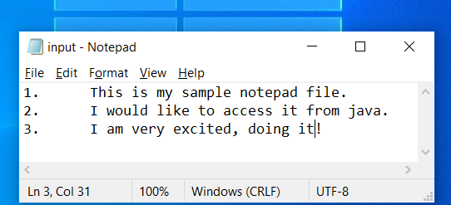
Reading a simple file Java File i/o…
Hey! I have a file named “input.txt” stored on my hard drive at Desktop, precisely →C:\Users\bilal\Desktop\input
I want to read this file and display its contents on the screen.
Can I?
Sure, you can. In Java it’s easy.

Slide 35

Reading a simple file…
The basic steps
Point the program to the location for loading the file from.
Associate a stream object to the file at step 1 for reading
Link a buffered reader to the reader stream object created at step 2.
Use functions of buffered reader for efficient reading as characters, lines etc.
step 1: File myFile= new File("input.txt");
step 2: FileReader myReader = new FileReader(myFile);
step 3: BufferedReader buffer = new BufferedReader(myReader);
step 4: String firstLine=buffer.readLine();
System.out.println(firstLine);

Slide 36

Reading a simple file…
import java.io.File;
import java.io.FileReader;
import java.io.IOException;
public class File_P1 {
public static void main(String args[]) {
try{
File myFile= new File("C:\\Users\\bilal\\Desktop\\input.txt");
//absolute path, remember to use \\ for windows
FileReader myReader = new FileReader(myFile);
BufferedReader buffer = new BufferedReader(myReader);
String firstLine=buffer.readLine();
System.out.println(firstLine);
}
catch(IOException exp) {
System.out.println("Exception occured of type "+exp.getMessage());
}
}
}
Output
1. This is my sample notepad file.
Exception occurred of type C:\Users\bilal\Desktop\inpt.txt (The system cannot find the file specified)

Slide 37
Reading a simple file…
Complete program
import java.io.BufferedReader;
import java.io.File;
import java.io.FileReader;
import java.io.IOException;
public class File_P1 {
public static void main(String args[]) {
try{
File myFile= new File("C:\\Users\\bilal\\Desktop\\input.txt"); //absolute path, remember to use \\ for windows
FileReader myReader = new FileReader(myFile);
BufferedReader buffer = new BufferedReader(myReader);
String line=buffer.readLine();
while(line!=null)
{
System.out.println(line);
line=buffer.readLine();
}
}
catch(IOException exp) {
System.out.println("Exception occured of type "+exp.getMessage());
}
}
}
Java file handling is prone to throwing exceptions.
Make sure to include it in a try block
Output
1. This is my sample notepad file.
2. I would like to access it from java.
3. I am very excited, doing it!

Slide 38
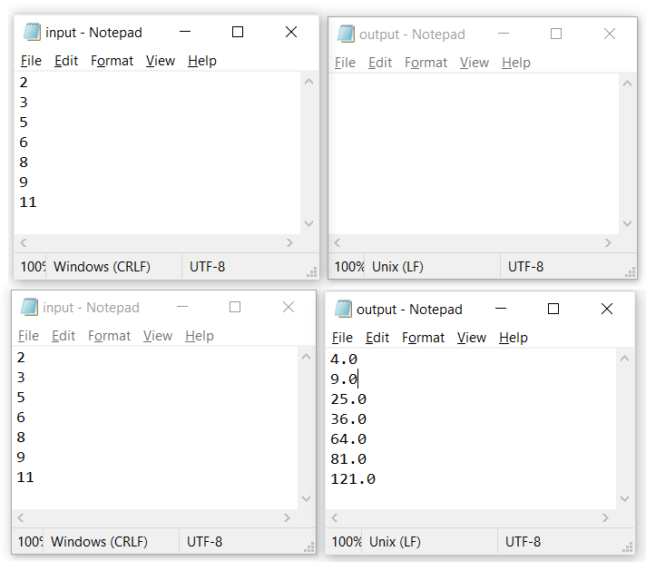
Practice
First thing first
Two files, we will be working with. input.txt & output.txt
File handlers, Stream objects and buffered objects associated with both input.txt and output.txt reading and writing respectively.
Yeah! Every file processing command shall be included in try and catch block for proper handling of exceptions, if any.
Reading numbers from file, taking square of each number being read and storing the result in another file.

Slide 39
Task-1: File Reading, Processing and Writing
fWriter.close();
bReader.reset(); //this reset buffered reader back to the point marked
FileReader oReader = new FileReader(output);
BufferedReader obReader = new BufferedReader(oReader);
String inValue,outValue;
inValue=bReader.readLine();
outValue=obReader.readLine();
while(inValue!=null && outValue!=null) {
System.out.println(inValue+"\t"+outValue);
inValue=bReader.readLine();
outValue=obReader.readLine();
}
bReader.close();
obReader.close();
}//end of try block
catch(IOException exp) {
System.out.println("Exception occured of type "+exp.getMessage());
}
System.out.println("********End of Program********");
}//end of main
}//end of class
import java.io.BufferedReader;
import java.io.File;
import java.io.FileReader;
import java.io.FileWriter;
import java.io.IOException;
public class File_P1 {
public static void main(String args[]) {
try{
File input= new File("input.txt");
File output= new File("output.txt");
FileReader fReader = new FileReader(input);
FileWriter fWriter = new FileWriter(output);
BufferedReader bReader = new BufferedReader(fReader);
bReader.mark(1000);//required for reset(). this will be used once we want to re-read the file
String line=bReader.readLine();
double value;
while(line!=null)
{
value=Double.parseDouble(line);
fWriter.write(Double.toString(value*value)+"\n");
line=bReader.readLine();
}

Slide 40
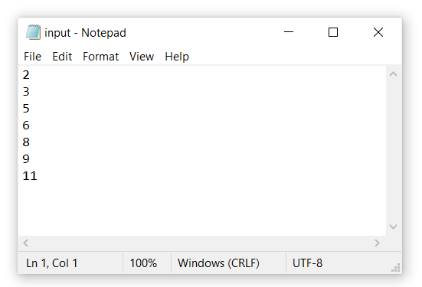
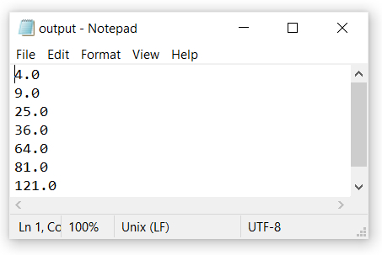
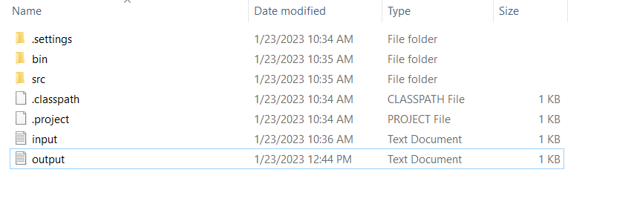

OUTPUT
2 4.0
3 9.0
5 25.0
6 36.0
8 64.0
9 81.0
11 121.0
********End of Program********

Slide 41
Writinig output of Task-3 to FileWorking and Output of the Program → TASK-4
public static void main(String commandLineArg[]) {
String[] names = new String[5];
int [][] marks = new int[5][3];
char[][] grade = new char[5][3];
int rollNo,subjectNo;
recordEntry(names,marks);
for(rollNo=0;rollNo<5;rollNo++)
for(subjectNo=0;subjectNo<3;subjectNo++){
grade[rollNo][subjectNo]=awardGrade(marks[rollNo][subjectNo]);
}
display(names, marks,grade);
writeToFile(names, marks,grade);
System.out.println("\n****************end of program******************");
}
}
public static void writeToFile(String[] names, int [][] marks, char[][] grades) {
String result="";
result+="\n*****OUTPUT*****\n";
//for simplicity we use i for student and j for subject
for(int i=0;i<5;i++) {
result+="Record of "+names[i]+"\nMarks obtained";
for(int j=0;j<3;j++)
result+=marks[i][j]+"\t";
result+="\nGrades awarded";
for(int j=0;j<3;j++)
result+=grades[i][j]+"\t";
}
result+="\n\nAll Students Record";
result+="\nMarks Obtained";
for(int i=0;i<5;i++) {
for(int j=0;j<3;j++)
result+=marks[i][j]+"\t";
result+="\n";
}
result+="\nGrades Awarded";
for(int i=0;i<5;i++) {
for(int j=0;j<3;j++)
result+=grades[i][j]+"\t";
result+="\n";
}
try {
File file=new File("record.txt");
FileWriter fw=new FileWriter(file);
fw.write(result);
fw.close();
}
catch(IOException exp) {
System.out.println("exception occured of type "+exp.getMessage());
}
}

Slide 42
Working and Output of the Program → TASK-4
*****OUTPUT*****
Record of Ali
Marks obtained
78 89 87
Grades awarded
C B B Record of Parker
Marks obtained
87 73 91
Grades awarded
B C A Record of Jones
Marks obtained
81 78 74
Grades awarded
B C C Record of Sarah
Marks obtained
83 56 40
Grades awarded
B E F Record of Rehan
Marks obtained
82 84 80
Grades awarded
B B B
All Students Record
Marks Obtained
78 89 87
87 73 91
81 78 74
83 56 40
82 84 80
Grades Awarded
C B B
B C A
B C C
B E F
B B B
****************end of program******************
Enter name of student no. 1
Ali
Enter marks obtained by Ali in subject no. 1
78
Enter marks obtained by Ali in subject no. 2
89
Enter marks obtained by Ali in subject no. 3
87
Enter name of student no. 2
Parker
Enter marks obtained by Parker in subject no. 1
87
Enter marks obtained by Parker in subject no. 2
73
Enter marks obtained by Parker in subject no. 3
91
Enter name of student no. 3
Jones
Enter marks obtained by Jones in subject no. 1
81
Enter marks obtained by Jones in subject no. 2
78
Enter marks obtained by Jones in subject no. 3
74
Enter name of student no. 4
Sarah
Enter marks obtained by Sarah in subject no. 1
83
Enter marks obtained by Sarah in subject no. 2
56
Enter marks obtained by Sarah in subject no. 3
40
Enter name of student no. 5
Rehan
Enter marks obtained by Rehan in subject no. 1
82
Enter marks obtained by Rehan in subject no. 2
84
Enter marks obtained by Rehan in subject no. 3
80

Slide 43
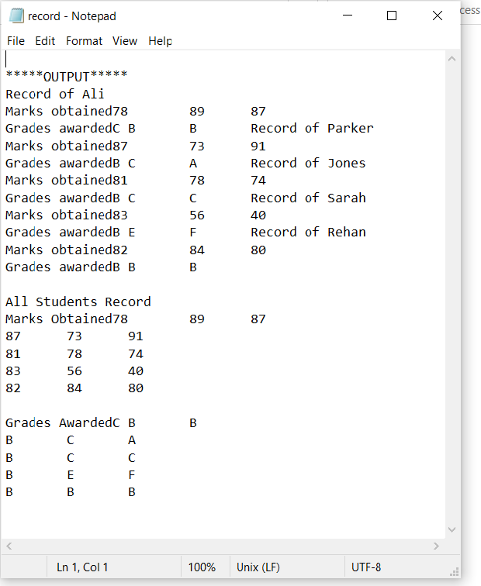
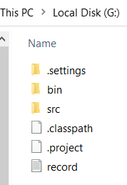
We have added one more function named writeToFile(….) for writing the formatted output to a file record.txt stored in relative position to the program running area.

Slide 44
File i/o and GUI
Just for fun!
Now we want to create a simple GUI application where we asking from user to enter his/her name, address, telephone number etc.
We want to store this information to a file created with name (firstName+lastName) and store it on secondary hard drive.
Can we do?
Yup, super easy and exciting.

Slide 45
Naveed do it

